Slide 1

Translation Agent
Bryan Tineo Ccasani

Slide 2
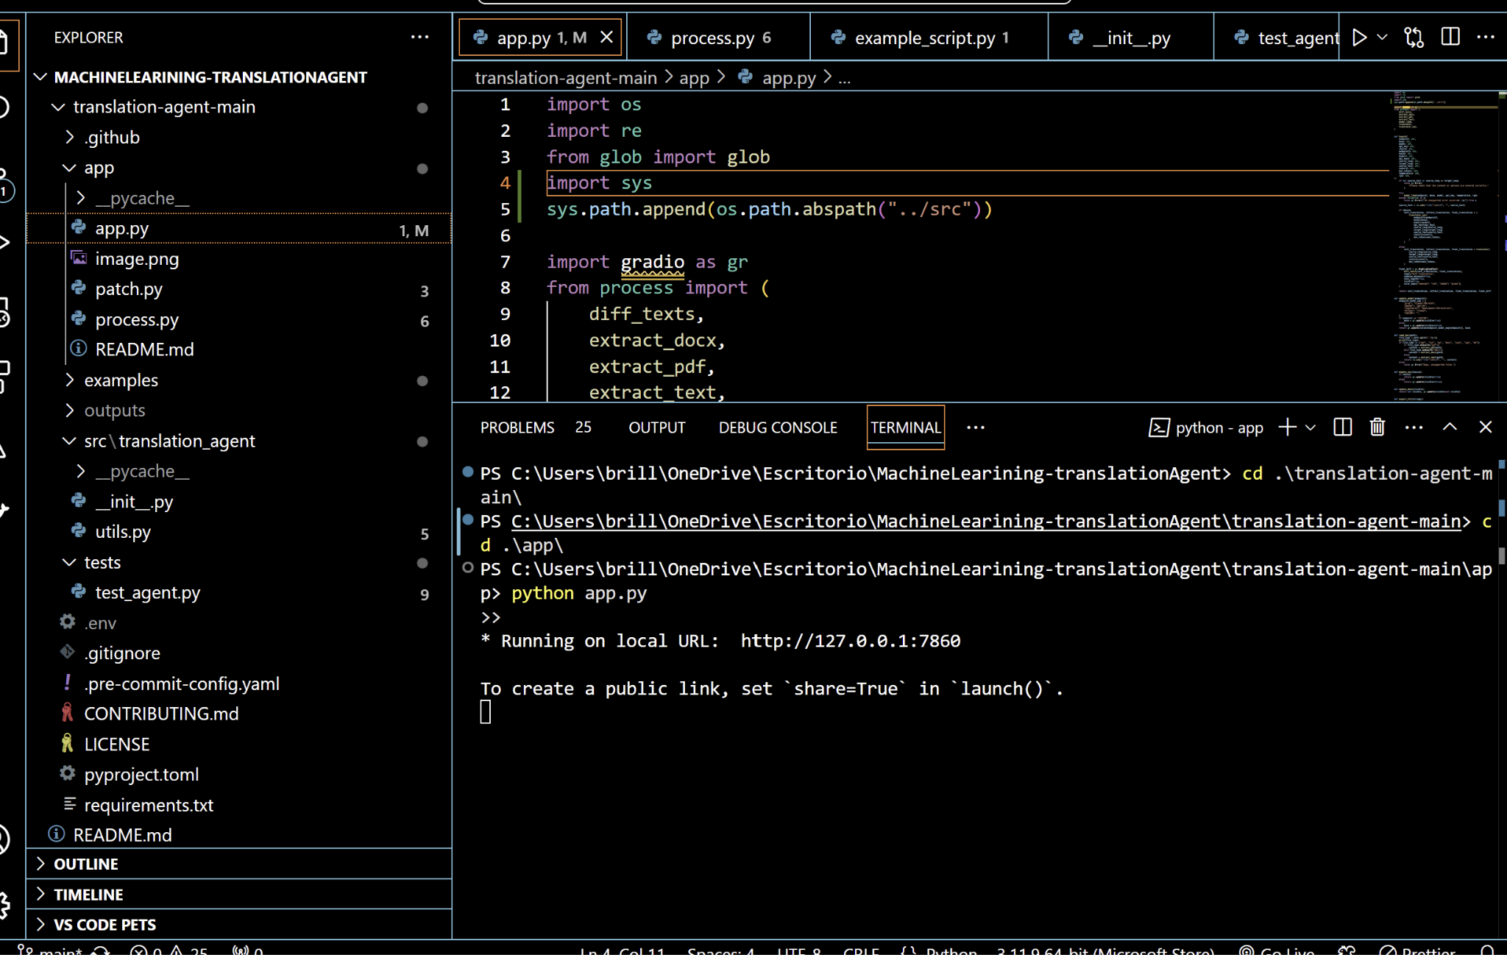
Download Repo: https://github.com/bryanmax9/MachineLearining-translationAgent
Open the project and use this command `cd .\translation-agent-main\`.Download modules with `pip install -r requirements.txt`.Move to app `cd .\app\`.Start application with command `python app.py`:
Click the terminal url
Setup

Slide 3
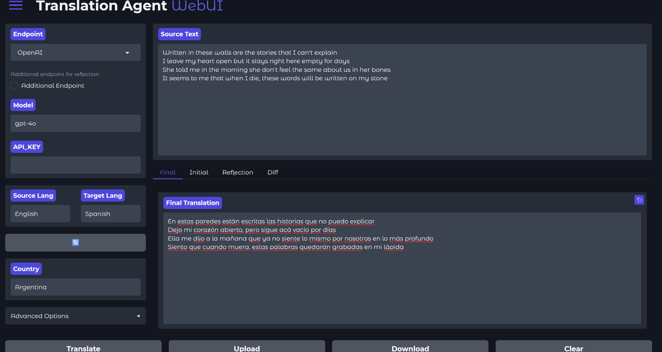

Translating English to Spanish

Slide 4
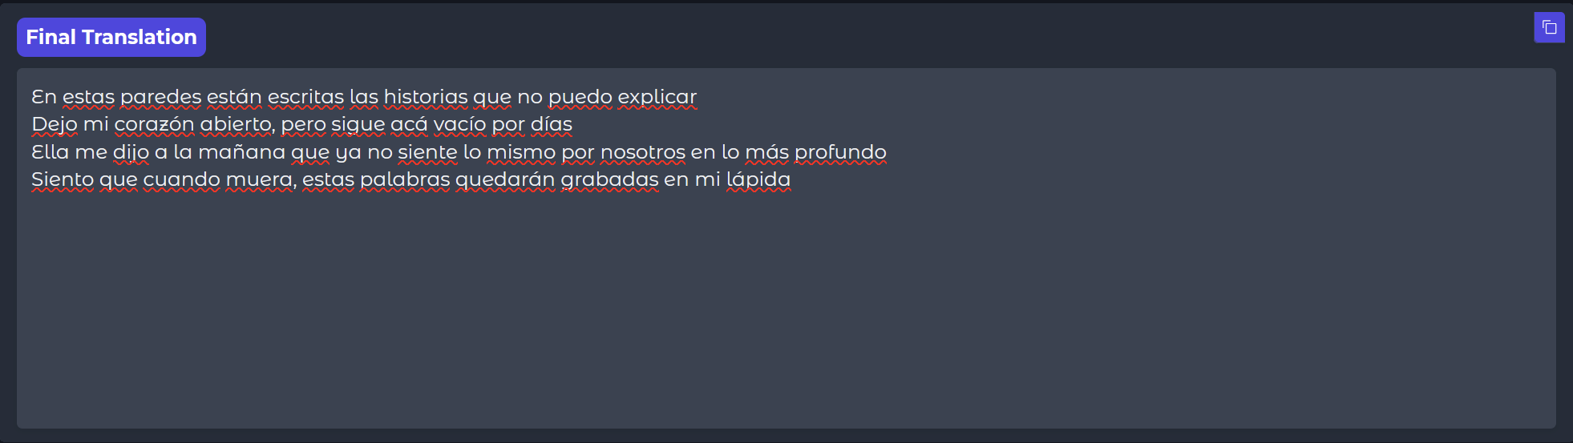

As you can see, the translation agent provides more poetically accurate and contextually aligned result compared to Google Translate which can sometimes sound more literal and less refined for artistic text like song lyrics.
What is the Difference?

Slide 5
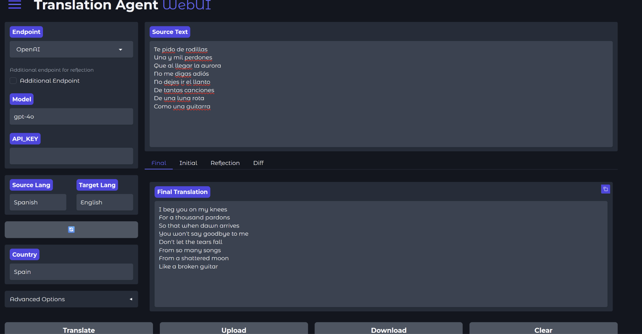

Translating Spanish to English

Slide 6


The translation tool performs better by preserving the lyrical tone and emotional depth of the original text, as seen in phrases like "shattered moon" versus Google Translate's "broken moon." It maintains fluency and poetic expression, making it more suited for creative content.
What is the Difference?

Slide 7
Translation Agent
Preserves the artistic and emotional essence of the original lyrics, capturing both the tone and depth of the source language.
Demonstrates greater nuance, capturing subtle expressions like 'lo más profundo' (the deepest feelings) instead of the literal 'en sus huesos' (in her bones), as seen in Google Translate.
Better aligns with the natural flow and stylistic expression of lyrics in Spanish.

Slide 8

Code Workflow
The application translates text in three stages:
Initial Translation: Produces the first-pass translation using an LLM.
Reflection: Reflects on the initial translation to identify areas for improvement.
Improved Translation: Applies the reflection insights to refine the translation.

Slide 9
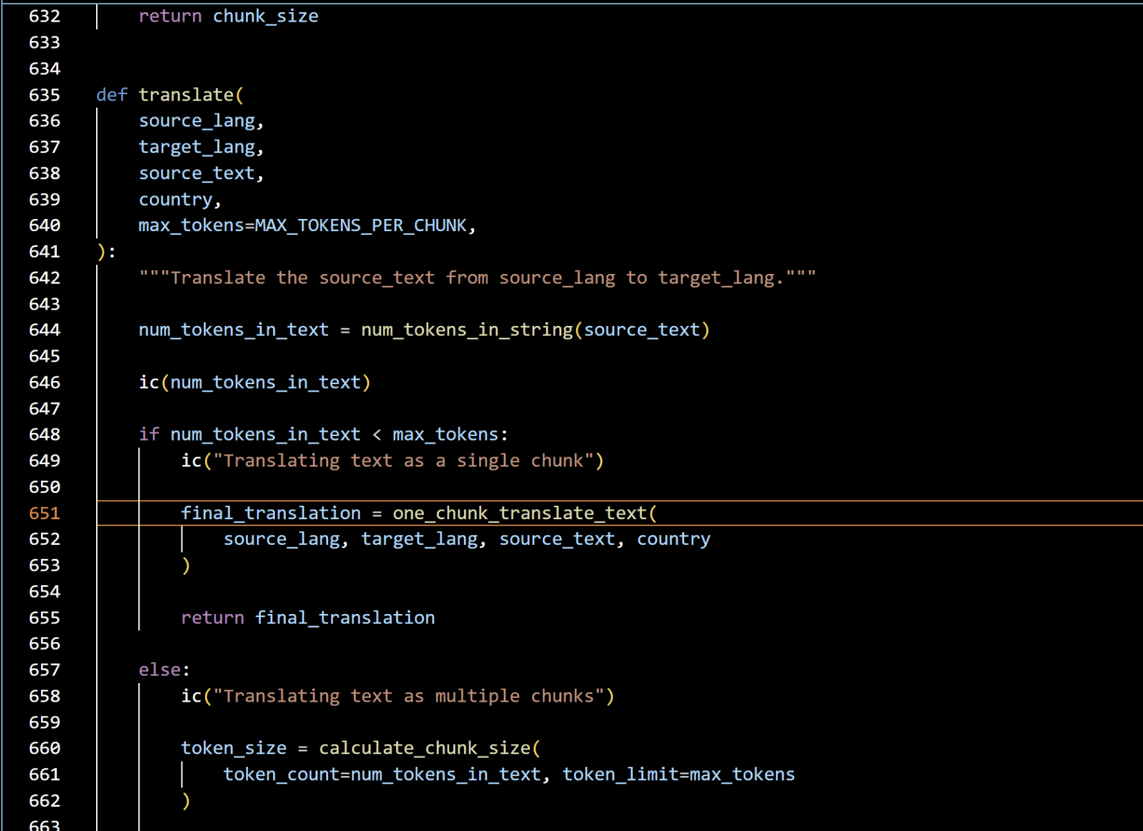
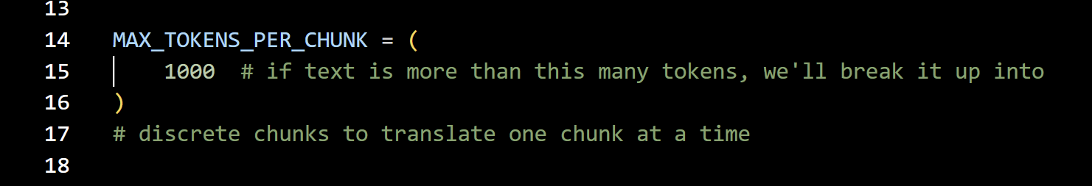
Chunk Management
The app, “utils.py”, it dynamically splits the source text into chunks if it exceeds a token limit (MAX_TOKENS_PER_CHUNK) to handle larger inputs efficiently.
It processes each chunk individually and then combines them into the final translation.

Slide 10

Advanced Features
Includes a second optional endpoint for “reflective translation” using a different model on the “app/app.py” file; you will need to adjust the “translator_sec()” function and associated Gradio interface elements.
Provides a detailed comparison between the initial and final translations using diffing tools on the “app/process.py” file on the function named “diff_texts(text1,text2)” which is partially implemented.
Integrates Gradio for an interactive web interface, allowing users to input text, configure options, and see results.

Slide 11

Key Code Components and Their Roles

Slide 12
app.py (Application Frontend and Main Logic)
Purpose: Defines the user interface and connects it to backend processing.
huanik(): Handles the core translation workflow, calling the backend functions to generate translations and reflections.
read_doc(): Extracts text from various file formats (PDF, DOCX, TXT)
diff_texts(): Highlights differences between initial and final translations for user insights.
switch(): Allows swapping source and target languages in the UI.
Gradio.Blocks: Creates a web-based UI where users can interact with the app

Slide 13
process.py (Backend Logic for Translation Workflow)
Purpose: Implements the core translation workflow logic, handling multi-chunk processing and text splitting.
translator(): Executes the primary translation process using OpenAI APIs. Handles text chunking for large inputs and calls “one_chunk…” or “multichunk_…” functions based on token limits.
translator_sec(): Adds support for a secondary endpoint (e.g., another LLM model) for enhanced reflection.
diff_texts(): Uses “difflib” to generate token-level diffs between translations.
extract_text(), extract_pdf(), extract_docx(): Extract content from various input formats.

Slide 14
patch.py (Model Configuration and API Interactions)
Purpose: Configures the LLM model and interacts with the OpenAI API.
model_load(): Sets up the appropriate API client based on the selected model and endpoint.
get_completion(): Sends requests to the OpenAI API for text generation.
rate_limit(): Ensures API requests adhere to rate limits, preventing throttling.

Slide 15
utils.py (Translation Utilities)
Purpose: Contains helper functions for tokenization, chunking, and detailed LLM interactions.
one_chunk_initial_translation(): Generates the first-pass translation for a single chunk.
one_chunk_reflect_on_translation(): Generates constructive suggestions for improving the translation.
one_chunk_improve_translation(): Applies the reflection to refine the translation.
calculate_chunk_size(): Dynamically calculates chunk sizes based on token limits.
multichunk_… Functions: Extends the single-chunk process to handle multiple chunks iteratively.
get_completion(): function forms the backbone of LLM interactions, handling prompts and system messages tailored for translation tasks.

Slide 16
Key Code Functions
The functions “one_chunk_reflect_on_teranslation()” and “one_chunk_improve_translation()” form the core of the reflection-agentic workflow in this translation application. They enable the iterative refinement process by first analyzing the initial translation for improvements and then applying those suggestions to produce a polished final output. Both are located at “utils.py”.

Slide 17

one_chunk_reflect_on_translation()
The one_chunk_reflect_on_translation() function is designed to generate constructive suggestions for improving translations by evaluating the initial translation against the source text. It assesses key aspects such as accuracy, fluency, style, and terminology to ensure a refined and contextually appropriate output. The function begins by setting the system_message to establish the LLM’s role as an expert linguist, which ensures that the model’s focus is directed toward linguistic and stylistic critique.
An optional country parameter allows the function to incorporate regional nuances into the translation, adjusting the tone and idiomatic expressions for specific cultural contexts like colloquial Spanish in Mexico. Using the reflection_prompt, the function provides the model with critical elements: the source text (<SOURCE_TEXT>), the initial translation (<TRANSLATION>), and detailed evaluation criteria. These criteria include accuracy (checking for mistranslations, omissions, or additions), fluency (ensuring grammar, syntax, and punctuation align with the target language), style (matching the tone and cultural context), and terminology (ensuring domain-specific consistency and precision).
The GPT model then generates a list of specific and actionable suggestions, such as rephrasing sentences, correcting grammatical errors, or refining terminology, which are subsequently used to improve the translation. This function plays a vital role in enhancing the overall quality and cultural relevance of the translation.

Slide 18

one_chunk_improve_translation()
The one_chunk_improve_translation() function refines the initial translation by applying the constructive suggestions generated by the one_chunk_reflect_on_translation() function. Its primary purpose is to produce a polished final translation that integrates the reflection's insights while preserving the original meaning of the source text. The function begins by defining the LLM’s role through the system_message, which establishes the model as an editor focused on improving translations based on detailed feedback.
The improvement process is guided by an improvement_prompt, which consolidates key elements for refinement. This includes the source text (<SOURCE_TEXT>), the initial translation (<TRANSLATION>), and the expert suggestions (<EXPERT_SUGGESTIONS>). The model is systematically instructed to address specific areas, such as accuracy (correcting mistranslations, omissions, or extraneous information), fluency (improving sentence flow and ensuring adherence to grammar rules), style (aligning the tone and structure with the source text’s intent), terminology (maintaining consistency and using contextually appropriate vocabulary), and any additional errors.
The function outputs an improved translation that incorporates the feedback while maintaining fidelity to the original meaning. By methodically applying expert suggestions, this function ensures the final translation achieves higher quality, fluency, and cultural relevance, making it more suitable for its intended audience.

Slide 19
Underlying Algorithm
Both functions leverage Prompt Engineering and the GPT model’s contextual understanding to implement a feedback loop
Reflection Phase (one_chunk_reflect_on_translation):
Evaluate translation quality based on detailed criteria.
Output structured feedback as a list of suggestions.
2. Improvement Phase (one_chunk_improve_translation):
Incorporate the reflection feedback into the original translation.
Generate an enhanced version that addresses the critique.

Slide 20

Conclusion
The use of one_chunk_reflect_on_translation() and one_chunk_improve_translation() showcases the power of iterative refinement in machine translation. While the functions rely heavily on GPT’s capabilities, their structured prompts and feedback-driven design emulate a professional translation process, delivering outputs that balance linguistic accuracy with contextual and stylistic nuances.

Slide 21

End of Presentation

